Slide 1
Data Structures and Algorithms -3 (25CS2103E)
Route Planning Application
Team Members
K. Yaminisai (2520030380)
L. Lekhana (2520030364)
Under the Esteemed Guidance of
Swathi mam, Assistant Professor, Dept. of CSE, KLH

Slide 2
Contents
Abstract
Introduction
Literature survey
Problem Statement and Objectives
Hardware and Software requirements
Results
Conclusion
Future Scope

Slide 3
Abstract
The Route Planning Application is a graph-based route optimization system designed to determine an efficient tour through multiple locations.
Locations are represented as vertices and roads are represented as weighted edges, where the edge weight denotes the distance or travel cost between two locations.
The system applies Dynamic Programming with Bitmask State Compression to solve a Travelling Salesperson Problem (TSP), finding a minimum-cost tour that visits every selected location once and returns to the starting location.
The application demonstrates practical use of graphs, dynamic programming, bitmask representation, state-space optimization, and route reconstruction.

Slide 4
Introduction
Finding an efficient route through multiple locations is an important optimization problem in transportation, delivery planning, and navigation systems.
The project models the route network as a weighted graph, where locations are represented as vertices and connections between locations are represented as weighted edges.
The application uses Bitmask Dynamic Programming to represent visited locations as states and systematically compute the minimum route cost.
The project's focus is threefold:
Efficient representation of route networks using graphs
Optimization of multi-location routes using Dynamic Programming
Reconstruction and visualization of the optimal route

Slide 5
Literature Survey
Dynamic Programming — A technique that solves optimization problems by dividing them into overlapping subproblems and storing previously computed results.
Travelling Salesperson Problem (TSP) — An optimization problem that determines the minimum-cost tour that visits every selected location exactly once and returns to the starting location.
Bitmask Dynamic Programming — Represents the set of visited locations using binary bits, reducing the need to explicitly store every possible subset.
Hamiltonian Path — A path that visits every vertex exactly once and forms an important concept related to route and path optimization.
Route Optimization Applications — Graph-based optimization techniques are widely applicable to delivery planning, transportation networks, and multi-location routing.
Gap identified: Basic shortest-path methods focus on travelling between a source and destination, whereas this project focuses on optimizing a complete tour involving multiple locations.

Slide 6
Problem Statement and Objectives
Problem Statement
Finding an efficient route that visits multiple locations exactly once and returns to the starting location becomes computationally challenging as the number of locations increases.
A systematic optimization approach is required to represent the visited locations, evaluate possible route states, and determine the minimum-cost tour.
Objectives
Represent locations and connections as a weighted graph.
Represent visited locations using a binary bitmask.
Apply Dynamic Programming to store and reuse optimal subproblem results.
Solve the multi-location route optimization problem using TSP.
Reconstruct and display the optimal route.
Analyze the number of DP states and algorithmic complexity.
Provide an interactive visualization of the optimized route.

Slide 7
Flow Chart
Input Locations
Select Starting Location
Model Network as Weighted Graph
Generate Bitmask States
Initialize DP Table — dp[mask][current]
Explore Unvisited Locations
Update Minimum Route Cost
Store Parent State
All Locations Visited?
Return to Starting Location
Reconstruct Optimal Tour
Display Route + Minimum Cost
How it works
At each state, the bitmask represents the locations already visited.
The Dynamic Programming table stores the minimum cost required to reach the current location for that particular visited set.
The process continues until all selected locations are visited, after which the minimum-cost tour is reconstructed.

Slide 8
Results
The application was tested using a weighted network containing multiple locations and connections. The system successfully:
Represents locations as graph vertices.
Represents route distances as weighted edges.
Generates binary masks for visited locations.
Computes DP states using Bitmask Dynamic Programming.
Determines the minimum-cost TSP tour.
Reconstructs the complete route.
Displays the optimal route visually on the graph.
Displays the final visited mask and DP state information.
Example Result
Locations: Hyderabad → Secunderabad → Kukatpally → Madhapur → Gachibowli → LB Nagar
Output — Optimal Tour: Hyderabad → ... → Hyderabad
Minimum Route Cost: calculated by the DP optimization engine
State Representation: dp[mask][current]
Time Complexity: O(n² × 2ⁿ)
Space Complexity: O(n × 2ⁿ)

Slide 9
Hardware and Software requirements
Hardware Requirements
Standard PC / Laptop
Dual-core processor or better
Minimum 4 GB RAM
Keyboard and mouse
Display monitor
Software Requirements
Operating System: Windows / Linux / macOS
Programming Languages: HTML, CSS, JavaScript
IDE: VS Code
Browser: Google Chrome / Microsoft Edge
Front-end Technologies: HTML5, CSS3, JavaScript
Algorithm: Bitmask Dynamic Programming
Problem Model: Travelling Salesperson Problem (TSP)

Slide 10
Conclusion
The Route Planning Application demonstrates how graph representation and Dynamic Programming can be used to solve a practical route optimization problem.
The project uses Bitmask Dynamic Programming to represent visited locations and efficiently compute optimal subproblems.
By applying the TSP model, the system determines a minimum-cost tour that visits every selected location and returns to the starting point.
The project demonstrates important DSA concepts including graphs, state compression, Dynamic Programming, route reconstruction, and algorithmic complexity analysis.

Slide 11
Future Scope
Support larger route networks with more locations.
Provide multiple optimized route options.
Include additional route constraints such as maximum distance or time.
Extend the system for delivery and logistics route planning.
Incorporate dynamic edge weights for changing travel conditions.
Improve visualization of DP states and route transitions.
Explore advanced optimization techniques for larger instances.
Extend the prototype into a complete intelligent route planning system.

Slide 12
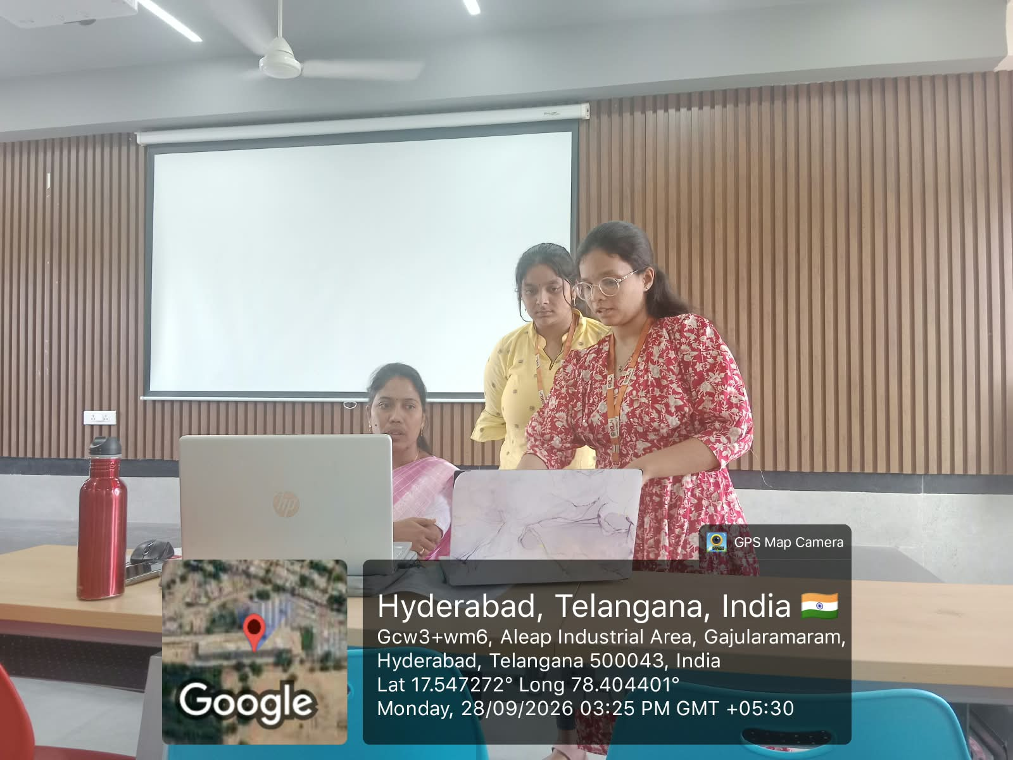
Geo-Tagged Photo

Slide 13
Thank you

